Slide 1
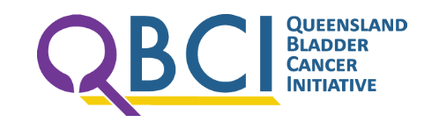
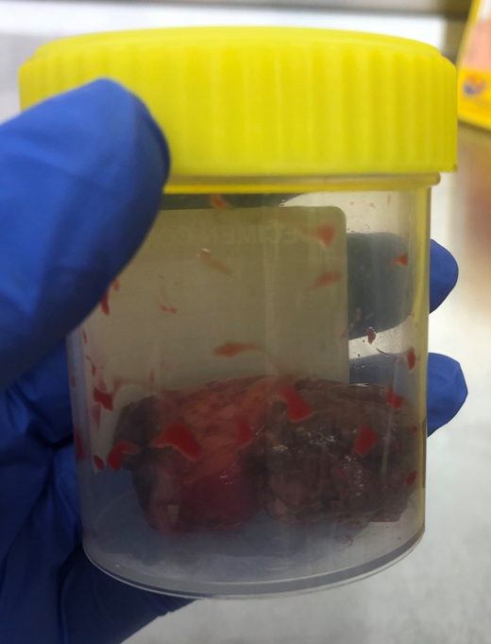
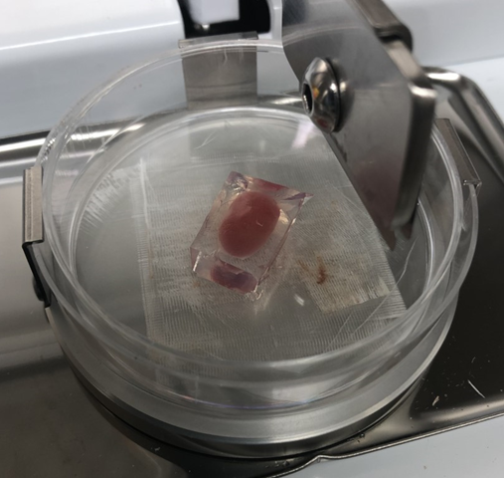
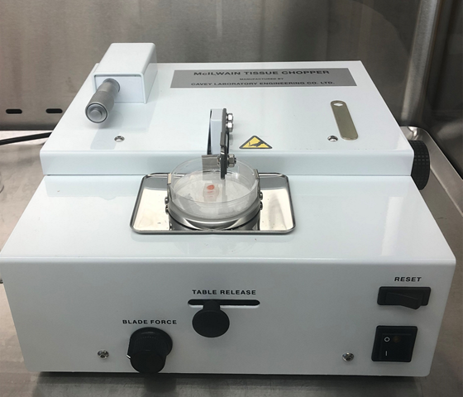
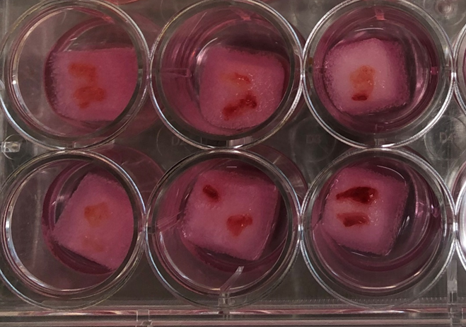
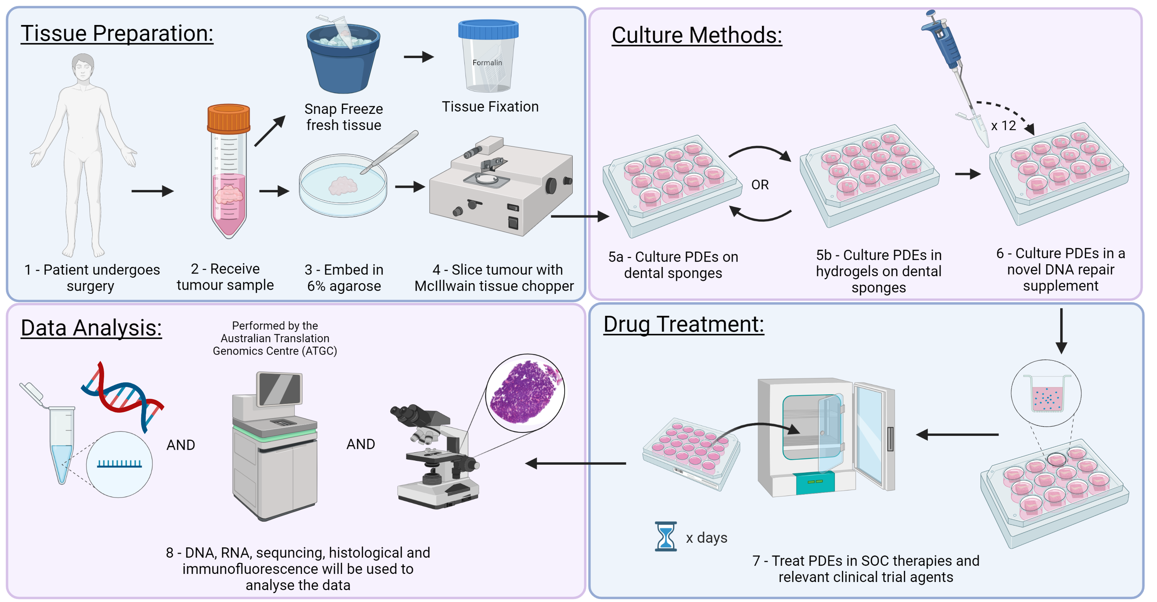
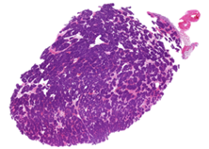
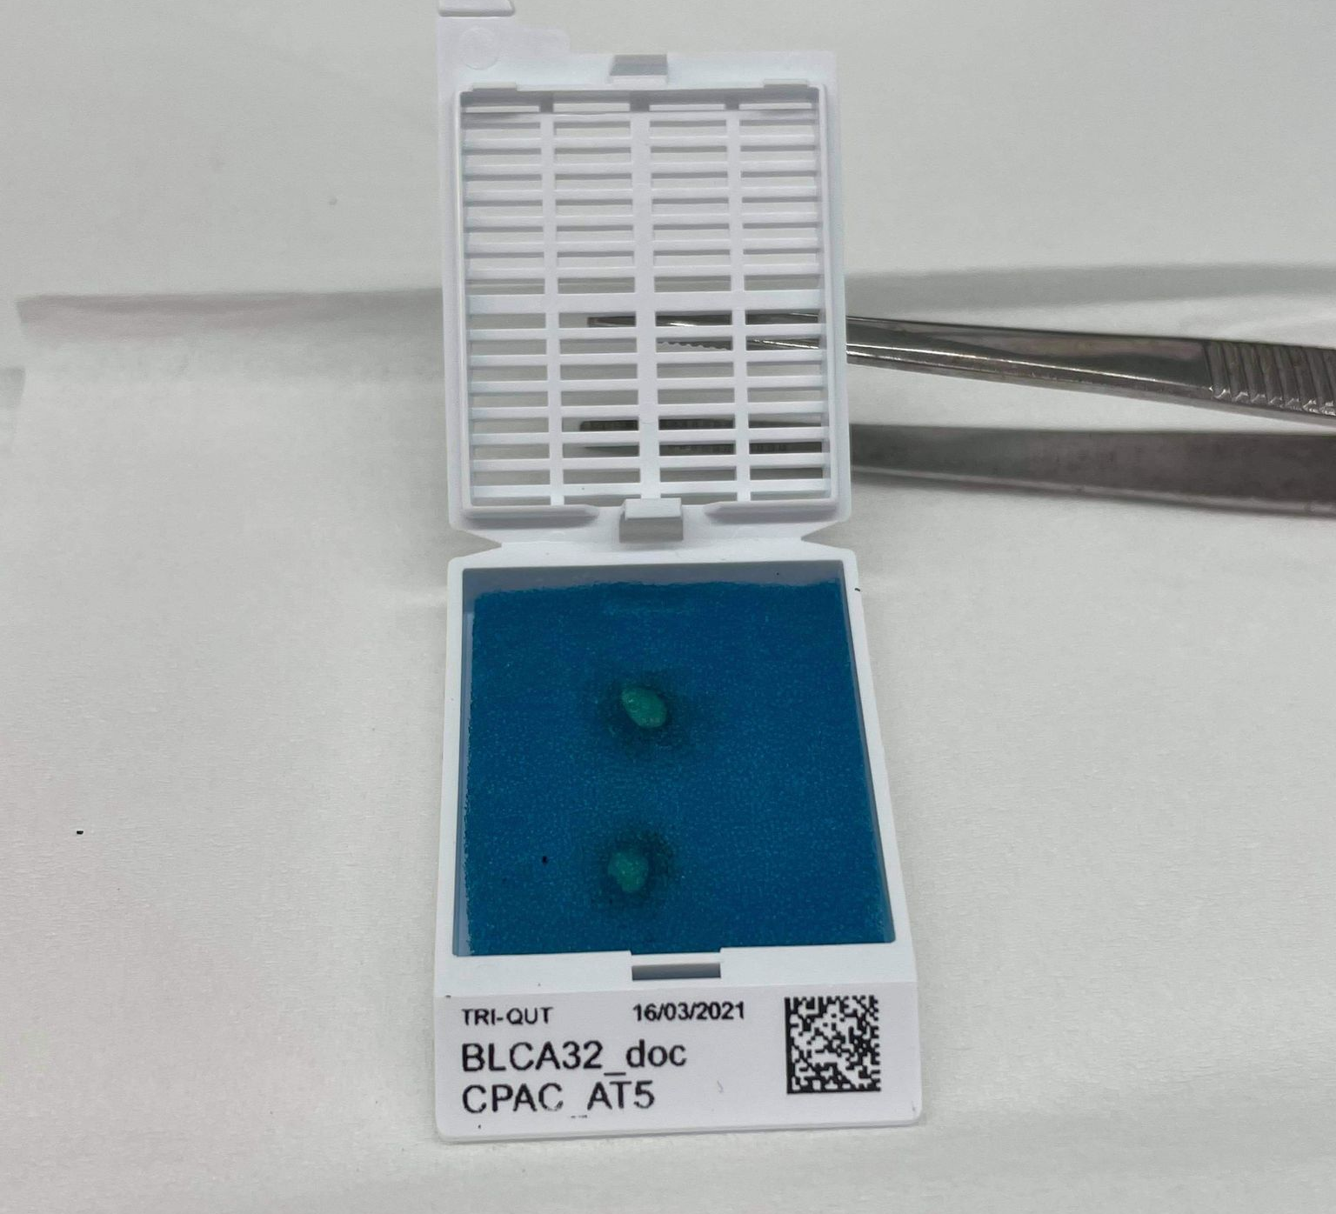
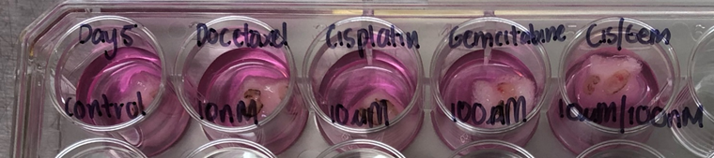



Improving Clinical Utility of Patient-Derived Explants as a Personalised Testing Platform
CPAC
Centre for
Personalised
Analysis of Cancers
Abby Templeton^{1,2,3,4}, Penny Jeffery ^{1,2,3,4}, Patrick Thomas^{1,3,4}, Laura Bray ^{1,5,6}, Ian Vela^{1,2,3,4,7}, Erik Thompson^{1,2}, Elizabeth Williams^{1,2,3,4}
¹ Queensland University of Technology (QUT), School of Biomedical Sciences, Translational Research Institute, Brisbane, QLD, 4102, Australia. ² Centre for Personalised Analysis of Cancers (CPAC), Brisbane, Queensland, Australia. ³ Queensland Bladder Cancer Initiative (QBCI), School of Biomedical Sciences, Queensland University of Technology (QUT), Translational Research Institute (TRI), Woolloongabba, Queensland, 4102, Australia. ⁴ Australian Prostate Cancer Research Centre – Queensland, Princess Alexandra Hospital, Translational Research Institute, Woolloongabba, Queensland, 4102, Australia. ⁵ School of Mechanical, Medical and Process Engineering, Queensland University of Technology (QUT), Brisbane, Queensland, 4059, Australia. ⁶ ARC Training Centre for Cell and Tissue Engineering Technologies, Queensland University of Technology (QUT), Brisbane, Queensland, 4059, Australia. ⁷ Department of Urology, Princess Alexandra Hospital, Brisbane, Queensland, Australia.
Introduction:
A robust patient-proximal ex vivo model will assist moving towards the integration of precision medicine techniques into clinical practice
Current models do not accurately address individual response to standard of care (SOC) therapeutics or reflect interpatient heterogeneity
Patient-Derived Explants (PDEs) are a candidate patient proximal model, as they maintain the original tumour microenvironment
A major concern is the short-term viability associated with PDEs. Further research into culture conditions is required for conversion to a long-term model
Proposed Methodology:
Propose the use of semi-synthetic hydrogels and novel supplements to improve viability of PDEs across tumour streams.
Whole exome sequencing helps identify intrinsic mutations related to resistance to SOC therapies.
Testing SOC therapies on PDEs, can indicate the best treatment for patients.
Summary:
The proposed methodology aims to improve the viability of PDEs across several tumour types using hydrogels and novel supplements
Combining a long-term patient proximal model, drug treatments and whole exome sequencing will assist with the progression of precision medicine methodologies
Preparing a timeline from the collection of a clinical sample to when the sequencing report is generated is critical to understand the required longevity of the PDE model
This approach has the potential to provide patients and their treating clinicians with functional information to assist with treatment decisions and ultimately improving patient prognosis

